Slide 1
CMN Collab Forum: Gender & Chronic Pain – Women’s Experiences Through an Intersectional Lens Hosted by: Dr. Cathy Scrimshaw Speaker: Dr. Fiona Webster May 26, 2022

Slide 2
Disclosure
Host: Dr. Cathy Scrimshaw
Relationships with financial sponsors:
Grants/Research support: N/A
Speakers Bureau/Honoraria: N/A
Consulting Fees: N/A
Patents: N/A
Other: I am a part time paid employee of the Alberta College of Family Physicians and Alberta Health Services.

Slide 3
Disclosure
Moderators: Dr. Leah Phillips, Maia Mudric & Jared Leeder
Relationships with financial sponsors:
Grants/Research support: N/A
Speakers Bureau/Honoraria: N/A
Consulting Fees: N/A
Patents: N/A
Other: Paid employees of the Alberta College of Family Physicians

Slide 4
Disclosure of Financial Support
This program receives financial support.
Financial support is received from the Alberta College of Family Physicians through a Health Canada Substance Use and Addictions Program contribution.
This program does not receive in-kind support
This program is presented by the Alberta College of Family Physicians without in-kind support.

Slide 5
Housekeeping
To capture your attendance, please click on the survey link in the chat to enter your name and email.
We will be using the chat log to collect questions.
You may use the “raise hand” feature to verbally ask a question.
There will be a dedicated time for Q&A at the end of the session.
An evaluation survey link will be posted in the chat log near the end of the session.

Slide 6
Bio
Speaker: Fiona Webster, Ph.D.
Bio: Fiona Webster is a critical sociologist and Associate Professor in the Labatt Family School of Nursing at Western University and holds a cross appointment with the Institute of Health Policy Management and Evaluation, University of Toronto, where she is also an Academic Fellow with the Centre for Critical Qualitative Health Research (CQ). She has successfully led many Tri-Council funded, interdisciplinary research teams with a particular focus on applying sociological approaches to understanding and improving care, with a particular focus on chronic pain and marginalization. By turning a sociological eye to the challenges of providing chronic pain care within parameters currently delineated by the Canadian health care system, her aim is to identify structural and ideological components of contemporary health care that might be amenable to change.

Slide 7
CMN Collab Forum:
Gender & Chronic Pain –
Women’s Experiences Through an Intersectional Lens
Fiona Webster, PhD
Western University
Twitter: @FionaWebster1

Slide 8
Learning Objectives
At the end of this session, participants will be able to:
1) Recognize the difference between sex and gender
2) Explain why and how gender matters in the context of chronic pain
3) Apply intersectionality to women’s experiences of chronic pain
4) Critically reflect on the experiences of women who have experienced gendered aspects of pain

Slide 9
Faculty/Presenter Disclosure:
Relationships with financial sponsors:
Grants/Research support: N/A
Speakers Bureau/Honoraria: Received a small honorarium for this presentation from the Alberta College of Family Physicians.
Consulting Fees: N/A
Patents: N/A
Other: Associate Professor in the Labatt Family School of Nursing at Western University; Academic Fellow with Centre for Critical Qualitative Health Research (CQ) - Institute of Health Policy Management and Evaluation, University of Toronto.

Slide 10
My positionality
@FionaWebster1
@cope_study

Slide 11
Sex and Gender
GENDER NORMS
culture based
(express expectations, values)
Sex
Gender
biological
construct
(chromosomes, sex organs, hormones, etc.)
socially constructed
(social roles, identities, behaviours)
@FionaWebster1
@cope_study
Notes:
What is gender? Why are we talking about this?
How do we understand the issues?
They probably understand that they treat men and women’s pain different, but they may not understand why
Gender is a broad category distinct from sex and includes research related to both women’s and men’s health as well as non-binary genders

Slide 12
Gender norms
Reproduce social beliefs such as the idea that men are inherently superior to women
For example, so-called masculine traits often more highly valued (independence, strength, etc.)
Research shows that these biases are evident in all health care, but especially in chronic pain
Samulowitz A, Gremyr I, Eriksson E, Hensing G. "Brave Men" and "Emotional Women": A Theory-Guided Literature Review on Gender Bias in Health Care and Gendered Norms towards Patients with Chronic Pain. Pain Res Manag. 2018 Feb 25;2018:6358624. doi: 10.1155/2018/6358624. PMID: 29682130; PMCID: PMC5845507.
@FionaWebster1
@cope_study

Slide 13
Examples of gender bias
Gender blindness
Hegemonic masculinity as the idealized norm
Andronormativity
@FionaWebster1
@cope_study

Slide 14
Chronic pain research to date has been largely dominated by biomedical research, meaning the social lens of gender is often not applied to our understanding of what have been largely described or researched as sex differences.

Slide 15
Quick stats
Men are disproportionately represented in opioid overdose deaths generally, but not so in overdose deaths relating specifically to prescription opioids (Cunningham et al., 2017).
Canadian women are more likely than men to live in poverty (Fox & Moyser 2018; Townson 2009), and these trends are even more pronounced for transgender women (Davidson 2015; Bauer 2009).
Finally, many women generally have greater caregiving responsibilities than men – and these responsibilities can take precedence over women’s own needs (Schulz & Beach 1999) while men are disproportionately employed in manual labour professions with high rates of workplace injury (OML 2016).
@FionaWebster1
@cope_study
Notes:
Chronic pain research is in serious need of critical engagement with these social, or gendered, aspects of chronic pain.

Slide 16
Women and chronic pain
Women tend to be over-represented among those with chronic pain conditions that are not straightforward in their diagnosis and treatment
Women are more likely to be prescribed medications for anxiety and to be prescribed lower doses of pain medication
With regard to gender norms, while more women are diagnosed with chronic pain syndromes, and it is more socially accepted for women to show pain, paradoxically, women’s pain reports are taken less seriously, and their pain is discounted as being exaggerated or imagined

Slide 17
Gender and chronic pain in the sociological literature
Chronic pain is a gendered experience, informed by inequities and stereotypes, that must be contextualized within the socially expected sets of behaviours, norms and roles of being a woman
it is not enough to take just a gendered lens as women’s experiences intersect with racialized identity, socio-economic class, sexual orientation, migration status, etc.
@FionaWebster1
@cope_study

Slide 18
Intersectionality
Originally developed as a critique of second wave feminism (Crenshaw 1989)
Noted that “woman” as an essentialized category was inaccurate
Gender mediated by other – and intersecting – identities such as race, class, sexual orientation, etc.
Further, identities are not fixed but historical, relational, contingent, ambiguous
@FionaWebster1
@cope_study
Notes:
The subject then is historical, relational, contingent, ambiguous
Also, we are constituted within language

Slide 19
What intersectionality adds
By defining and describing our own (multiple) social locations:
Enhances clinician self-awareness
Heightens communication and understanding
Also allows physicians to find commonality rather than to assume differences
@FionaWebster1
@cope_study

Slide 20
Critiques of intersectionality
Is based on a misunderstanding of feminist theory and history
Overwhelming focus on the individual
Naming off a list of “privileges” simply states the existence of an unequal society—it does not help us to understand it or to challenge it.
Ignores systems of oppression
Esme Choonara and Yuri Prasad. What’s wrong with privilege theory? In International Socialism, Issue 142, April 2014.
@FionaWebster1
@cope_study

Slide 21
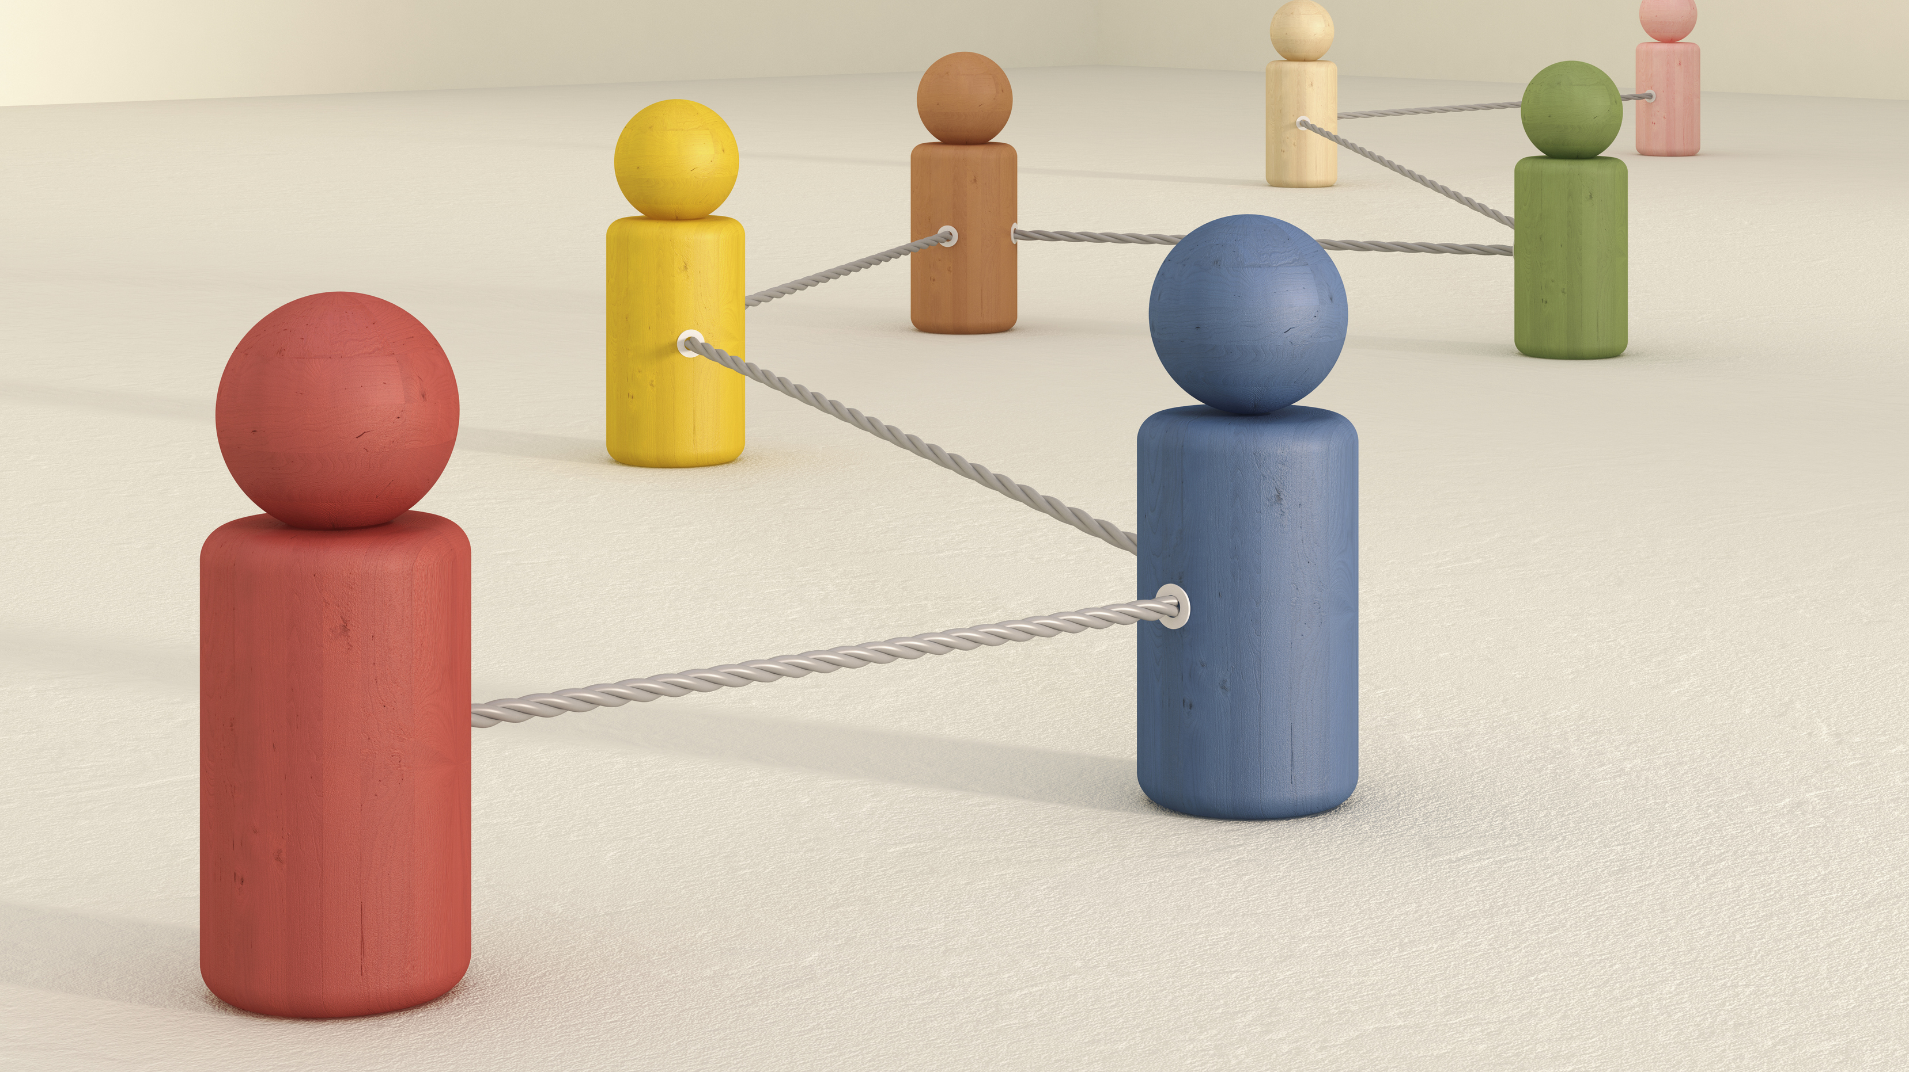
COPE II - An institutional ethnography (IE) of chronic pain and marginalization
Fiona Webster, Laura Connoy, Abhimanyu Sud, Andrew Pinto, Craig Dale, Joel Katz, Kathleen Rice, Ross Upshur

Slide 22
COPE II Study
1
3
5
2
4
Gendered
poverty
Stigmatized pain conditions
Mothering
Relational aspects
of pain management
Inter-generational poverty and
its links
with abuse
@FionaWebster1
@cope_study

Slide 23
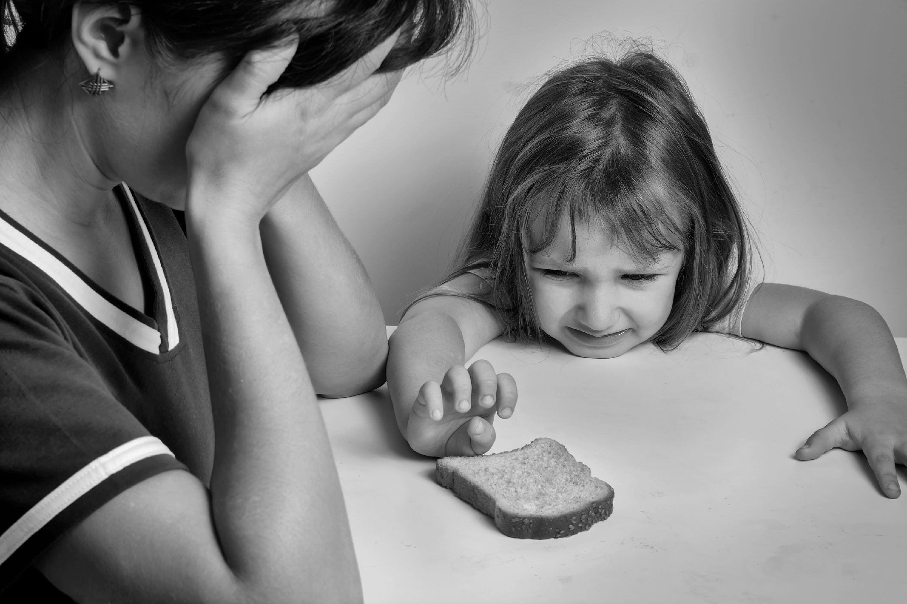
1. Gendered poverty: the work of living with violence, trauma and single motherhood

Slide 24
1. Gendered poverty
“I was, I separated 2 years ago; I was in a very abusive marriage for 26 years. But my ex-husband earned a very good wage so I could afford most of my treatments. Since we separated, he provides very minimal support and is trying to ruin that. So, I basically can’t afford the management plan my doctors set up in 2016”
@FionaWebster1
@cope_study
Notes:
Lisa lives with two neurological conditions (chronic regional pain syndrome and thoracic pain syndrome) due to a car accident. She applied for CPP disability and PWD after the pain became too much after returning to work. She says her neurological-based pain is unresponsive to most medications and the ones that do work are not covered; in fact 90% of her pain management plan is not covered.

Slide 25
1. Gendered poverty
My ex-husband doesn’t give me any child support. Never has. We do 50/50 custody, that’s been his reasoning for not doing child support and he won’t do mediation with me anymore. So, now it’s either I take him to court or or just deal with the situation. And he’s very vindictive. So, if I do take him to court, then that means that he’s gonna make my life difficult for an extended period of time.
@FionaWebster1
@cope_study
Notes:
Uma is in her 30’s and lives in a subsidized housing complex in B.C. with her son and boyfriend. She has struggled with chronic pain for almost her entire life, and lived through a traumatic childhood. Uma has trouble making ends meet due to various factors: living in B.C., having to pay out of pocket for pain management, and not being able to earn enough money. It has come to the point where, even though she prioritizes rent, she has gone hungry so her son can eat.

Slide 26
1. Gendered poverty
So, being a single mom, yeah, huge difference. I know that everyone, all parents, are stressed, I get that. I think just living below the poverty line, not having another paycheque in the house, it just adds so much stress. Plus, having to do everything myself. Not having anyone to bounce, you know, to support me in either discipline or, “How are we going to deal with my son, [name], failing school again?” like, “How -?” you know, I don’t have that kind of support. So, everything’s always on me. And it’s just so overwhelming. It always has been and it still is.
@FionaWebster1
@cope_study
Notes:
Sophie is also a single mother, is in her 50s, and lives with multiple physical and health conditions. She has been unable to work due to her pain and therefore relies on disability assistance, which provides inadequate amounts of funding for her to maintain a decent quality of life. For example, she lives in subsidized housing and struggles to afford the cost of prescribed alternative therapies. Yet, Sophie claims doctors do not take her pain experiences seriously and that doctors assume she has access to resources to manage her pain. She feels that her pain is at least partially related to her traumatic childhood, in addition to the stresses of being a single mother and the work of “having to do everything by myself”.

Slide 27
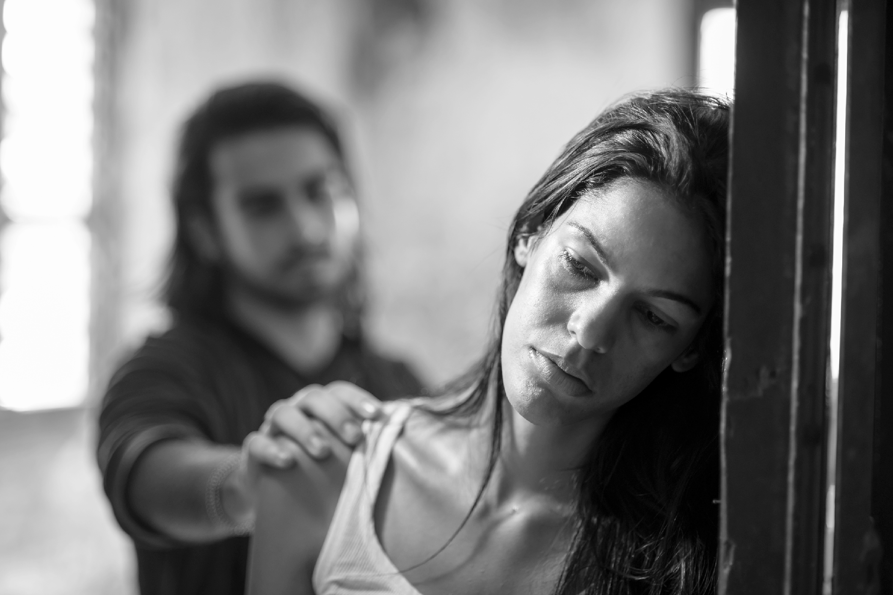
2. The work of managing intergenerational poverty

Slide 28
2. The work of managing intergenerational poverty and its links with gendered violence
Yeah, so, my daughter, she’s [in her twenties], she has two young children. Last fall, she left her husband, and so, her and the kids ended up here. […] My daughter moved in … around the same time, pretty much, that I left the job, she moved into my house … And, because she wasn’t in a good state emotionally, I ended up taking care of the children, even though I wasn’t in a good place. And I’m still doing it. My son has issues, as well. He’s got ADHD and pretty bad anxiety. So, he was - he’s had a really rough year at school. So, it’s just been a lot on me, both of them with their mental health issues, me with my mental health issues and my pain issues […] And then, what’s happened really recently is, my daughter is moving to - I’m in [B.C], so, she’s moving to the coast, and she’s not taking her kids and she’s going to come back two days a week to see them because she’s feeling like she’s going to have more opportunities to make some money there. So, once again, I’m [sighs] - I just always seem to be taking care of other people. I don’t really feel like I have an option not to, because I think if I don’t take care of my grandchildren, we might lose them. Like, to the other grandparents and the dad […] So, I’m taking care of them. So, this whole time I’ve been off work, I’m supposed to be taking care of myself, and although I’ve been doing a lot of mental health groups and I’ve been trying to, like, keep on top of exercising for my pain management, it’s been very challenging. (Sophie)
@FionaWebster1
@cope_study
Notes:
In addition to feelings of guilt, we learned how managing chronic pain is complicated by the care work performed by women. Sophie elaborates on how the responsibility of caring for her children supersedes her ability to care for herself.
Some of the poverty discussed by the participants was intergenerational
The challenges of accessing safe and affordable housing, growing up in a low income household, and living in neighbourhoods with high crime rates, low-quality education, and limited access to preventative healthcare significantly shapes access to certain resources to create wealth and wellbeing
Interventions that might provide assistance within a single life (i.e. increased rates of social assistance) may not be sufficient to undo the harms inflicted through generations of poverty

Slide 29
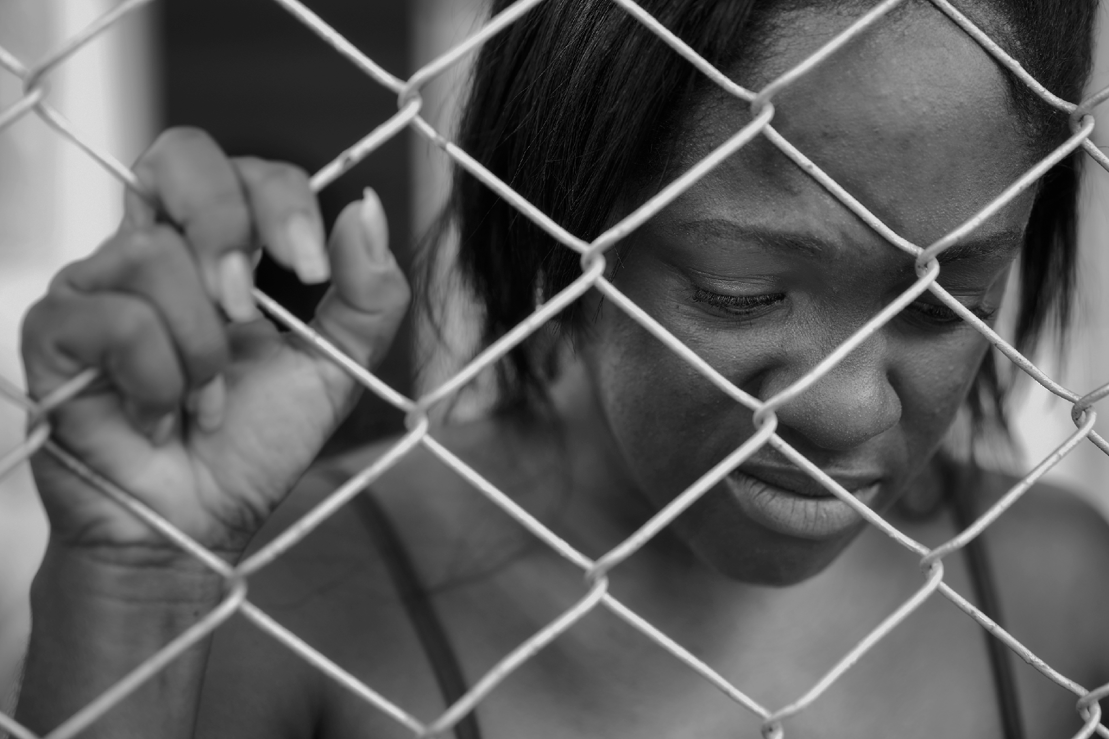
3. Stigmatized pain conditions

Slide 30
3. Stigmatized pain conditions
The majority of the doctors that I have gone through have been helpful and hurtful. They don’t, not every doctor believes in say fibromyalgia. And not every doctor has the training to recognize certain symptoms of certain other diseases and disorders. […] So I’ve had to go through a large quantity of different doctors, not only because I didn’t have a family doctor right away, but because there are doctors that would just see me as this overweight girl complaining. I have found many a time there have been doctors that just assume that I just don’t eat right because I look fat and it’s like, well, what does your body do when you don’t eat consistently and you have poor quality of food to eat? It hoards. It holds, it hoards. It’s like, I shouldn’t have to correct the doctor. And when you do have to inform the doctor and they find it condescending, you don’t get very far. (Poppy)
@FionaWebster1
@cope_study
Notes:
Poppy struggles with many issues. In her mid-30s, she comes from an abusive childhood in that her mother did not believe the pains she was experiencing as a teenager. She claims she had to sneak away to the clinic to get help. It wasn’t until she moved out at the age of 19 that she was able to take more control of her health and start to receive proper diagnoses and treatments. Living on social assistance as a person with a disability (which she says was a difficult application process), she finds it difficult to make ends meet. In order to help make ends meet she makes jewellery. She is also working with her doctor in order to be able to start working a part-time job. She is currently waiting to get into a pain management clinic (2 year wait).

Slide 31
4. Relational aspects of pain management

Slide 32
5. Relational aspects of pain management
I do have a husband, but unfortunately my husband he, when I say I’m in pain he actually kind of feels that he’s in pain, because he doesn’t like seeing me in pain, if that makes any sense. So, I can’t really rely on my husband, because I don’t want to get him upset and I have to rely on myself, I have to, like I meditate and it’s usually just me dealing with my pain; I have no support system. (Hannah)
I don’t want to make him sound like he’s not a good person, but he just doesn’t, he just doesn’t do well with other people suffering. And so his way of managing that is to stay out of – to stay away, because he doesn’t feel like he manages it well on his own. He doesn’t manage watching me suffer, very well. So his way of managing that is to just keep space between us (Violet).
@FionaWebster1
@cope_study
Notes:
In these stories, we hear how the needs, thoughts and emotions of women are set aside to ensure the wellbeing of their partner. In Hannah’s case, she avoids discussing her chronic pain with her husband to avoid upsetting him, leaving her effectively without a support system. The relational aspects of pain management narrows in on the ways that womens lives are not independent but rather deeply embedded in relationships and responsibilities for others that is largely unrecognized in chronic pain management literature. In the stories shared by the women we spoke to, the emphasis was not simply on experiences with chronic pain and how to manage it, but also how this is intertwined with responsibility and concern for others, largely partners and children, which occurs at the expense of their wellbeing.

Slide 33
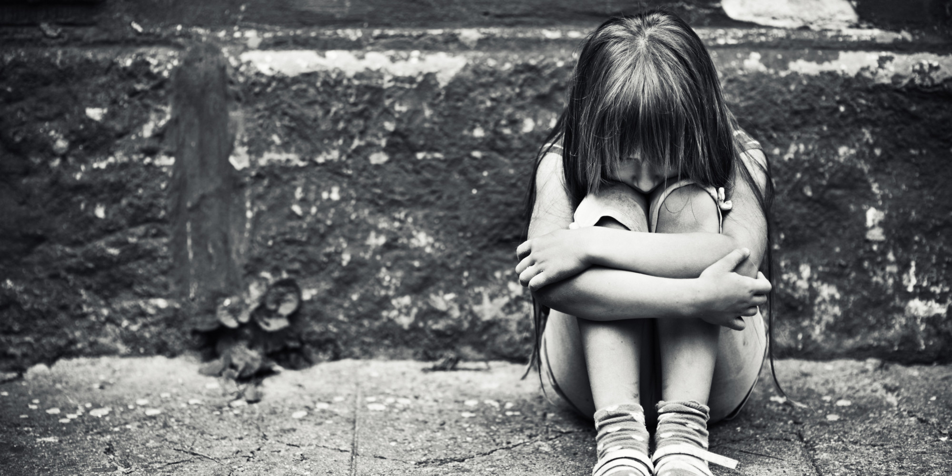
5. Pain and mothering

Slide 34
4. Pain and mothering
There’s a lot of mum guilt, because I can’t always do what other mums can do. I can’t, like, when he was a baby, I remember struggling a lot, because I couldn’t really lift him. That was another indicator to myself that something was wrong, because I could barely lift my son […] So it was kind of frustrating being in pain, not being able to also have those beautiful motherly, mother moments with your child. And then like, I feel like I sometimes, like I have to cut so many corners with certain things, because maybe my health is acting up. (Natasha)
@FionaWebster1
@cope_study
Notes:
Several of the women we spoke to discussed the relational aspects of chronic pain management, specifically as it pertains to partners and children. For example, Natasha highlighted the guilt she feels because her chronic pain does not always allow her to “do what other mums can do”.

Slide 35
Discussion
The many gendered aspects of chronic pain create particular forms of work that are often invisible
Impacts women’s lives as well as interactions with clinicians
Gender intersects with race, sexual identity, poverty, gendered violence and trauma in complex ways
Social theory, and social science approaches, can help us to understand the multiplicity of women’s experience and hopefully transform practice and policies
Understanding our own gender biases is a necessary but insufficient solution in this direction
We are all products of our society and thus of course are shaped by the prevailing norms of our cultures, our positions, and our social characteristics
Gender bias thus becomes normalized and is difficult to recognize
Need to think about how we “hear” people’s stories and what treatments we can offer in response
Need for continued political action
@FionaWebster1
@cope_study

Slide 36
Some questions for discussion
How often do you hear these stories in your practices? How do you respond?
Are you aware of your own intersecting identities?
What would you most like to learn about gender?
What do you think are the most important future areas of research?
@FionaWebster1
@cope_study

Slide 37
Last CMN Events Before Summer!
Chronic Pain Gains in Alberta: An ECHO Series:
June 1st – Didactic presentation by Dr. Tina Korownyk on PEER’s Pain Calculator followed by a complex chronic pain case discussion.
June 15th – Didactic presentation by Dr. Nancy Easton on Opioid Use Disorder & Chronic Pain followed by a complex chronic pain case discussion.
Both sessions are 4:30-5:45 pm
June 8th 7:00-8:30 pm Kímmapiiyipitssini: The Meaning of Empathy, Movie Access & Panel Discussion

Slide 38
Not a member of the CMN?
Join today to get on the mailing list for upcoming events and resources!
Membership is always free
Participation is up to you – join as a general member, or participate in mentorship as a mentee, mentor, or both!
Check out the website for more info:
https://cmnalberta.com/

