Slide 1
How to DO Trauma Informed Care & Repair Relationships that Go Wrong Hosted by: Dr. Cathy Scrimshaw Speakers: Kara Irwin & Marie Ferraro April 28, 2022

Slide 2
Disclosure
Host: Dr. Cathy Scrimshaw
Relationships with financial sponsors:
Grants/Research support: N/A
Speakers Bureau/Honoraria: N/A
Consulting Fees: N/A
Patents: N/A
Other: I am a part time paid employee of the Alberta College of Family Physicians and Alberta Health Services.

Slide 3
Disclosure
Moderators: Dr. Leah Phillips, Maia Mudric & Jared Leeder
Relationships with financial sponsors:
Grants/Research support: N/A
Speakers Bureau/Honoraria: N/A
Consulting Fees: N/A
Patents: N/A
Other: Paid employees of the Alberta College of Family Physicians

Slide 4
Disclosure of Financial Support
This program receives financial support.
Financial support is received from the Alberta College of Family Physicians through a Health Canada Substance Use and Addictions Program contribution.
This program does not receive in-kind support
This program is presented by the Alberta College of Family Physicians without in-kind support.

Slide 5
Housekeeping
To capture your attendance, please click on the survey link in the chat to enter your name and email.
We will be using the chat log to collect questions.
You may use the “raise hand” feature to verbally ask a question.
We will be using breakout rooms today – please click the “Join” button when it appears on your screen.
There will be a dedicated time for Q&A at the end of the session.
An evaluation survey link will be posted in the chat log near the end of the session.

Slide 6
Bio
Speaker: Kara Irwin, M.Sc., R.Psych
Bio: Kara is a Clinical Psychologist specializing in trauma and the far-reaching impacts on physical and psychological quality of life. Kara’s worked in private practice, not-for-profit, provincial health care, and research settings. Kara is proudest of her work with AHS on integration of true interdisciplinary mental health supports into primary medical care to make quality mental health supports easily accessible to high-risk populations. Kara’s currently completing her PhD in Community Medicine and her thesis research involves health innovation to manage multimorbid chronic disease in patients with a history of childhood psychological trauma. This research builds on her master’s in Clinical Psychology which focused on trauma and pain in Canadian Veterans.

Slide 7
Bio
Speaker: Marie Ferraro (AAWEAR)
Bio: Marie is the Provincial Community Engagement Manager for the Alberta Alliance who Educates and Advocates Responsibly (AAWEAR).⁠ Marie identifies as a recovered addict and alcoholic and spent nearly two decades struggling to manage her relationship with drugs and alcohol. Marie chooses to live a life free from all mind-altering substances and understands the importance of harm reduction practices. AAWEAR actively engages with local organizations to educate and inform them on life-saving harm reduction practices. The team provides the drug-using community with comprehensive, low-barrier access to the “supports n’ supplies” they need and deserve.

Slide 8
How to DO Trauma Informed Care & Repair Relationships that Go Wrong
Marie Ferraro from AAWEAR and Kara Irwin
Notes:
-Marie to read title
-We each quickly introduce ourselves

Slide 9
Disclosure
Speaker: Kara Irwin
Relationships with financial sponsors:
Grants/Research support: University of Calgary, Strategies for Patient Oriented Research – PhD student scholarships
Speakers Bureau/Honoraria: N/A
Consulting Fees: N/A
Patents: N/A
Other: Employee – City University, University of Calgary, and Irwin Psychological Services
Received an honorarium from the Alberta College of Family Physicians for this presentation.

Slide 10
Disclosure
Speaker: Marie Ferraro
Relationships with financial sponsors:
Grants/Research support: N/A
Speakers Bureau/Honoraria: N/A
Consulting Fees: N/A
Patents: N/A
Other: Employee – Alberta Alliance Who Educate and Advocate Responsibly (AAWEAR).
Received an honorarium from the Alberta College of Family Physicians for this presentation.

Slide 11
Learning Objectives
1) Identify when a scenario in addictions work is trauma informed and when it is not.
2) Comprehend and describe a model of how substance misuse and addiction may evolve from trauma.
3) Use a model to generate trauma informed strategies for supporting patients with addictions.
4) Recognize when a relationship strain has taken place.
5) Identify repair strategies for when a trauma informed transgression has taken place.
Notes:
-Kara
-Give a brief overview of the plan for the session

Slide 12
Trauma Informed Care Aims To:
… recognize the far reaching impacts of trauma.
… understand, recognize, and respond to the effects of trauma.
… create room for safer spaces.
… establish an internal locus of control and sense of empowerment.
Notes:
Kara to discuss slide.
Marie to discuss= Be careful of statements like “this is a safe space”. We don’t know what is safe and what isn’t and for some of our clients, safety isn’t safe.

Slide 13
A Note On Language
Marie’s Perspective
Kara’s Perspective
Notes:
Marie:
-Addiction is not necessarily wrong but is an outdated term.
-Poisoning vs overdose
-It’s more about personalized meaning. The person is the expert.
-Offer some concrete ways to talk about the patients perspective.
Kara:
-Addiction isn’t about the substance or the behavior, it’s about how it’s used.
-I consider addiction an unconscious use of external “stuff” used to fill the role of internal “stuff”.

Slide 14
Etiology of TIC Mistakes
Personal bias or stigma
Structural and/or educational bias or stigma
Lack of knowledge or misunderstanding of knowledge
Burnout, lack of empathy, fear
Notes:
Kara
-If we can understand where our errors may come from, we are in a better place to prevent, identify, and correct them.
-Well meaning providers may take agency away accidentally by trying to support patients who have been through trauma.
-Kara to provide example of Mast Cell and pain medication treatment in emergency.
-Marie to provide an example about structural stigma. Substance use ”managed better” in order to access supports.

Slide 15
Antidotes to TIC Mistakes
Curiosity
Openness
Education
Creativity
Tenderness
Notes:
Marie
-Curiosity and openness to self exploration and examining our own bias. And to critically examining our settings and structures.
-Education and knowledge on best practice. Examining multiple sources and types of information.
-Creativity in curating knowledge to the individual
-Tenderness to the self and to others.

Slide 16
Case Study - Primer
26 yo male presents with shoulder pain after a weightlifting injury at the gym. He wants to get better quickly so he can get back to working out. Wondering about pain medication.
Had a rough childhood and used substances as a youth to cope. No substances since 20 yo.
Taking a pre-workout, BCAA’s, creatine, and OTC sleep.
Tried rest, ice, and OTC pain relief. Reported they didn’t help. Hesitant about physiotherapy.
Notes:
Kara
-Think – pair – share activity.
-1 min to think on own
-5 min to do small group work
How would you approach treating this patient

Slide 17
Marie – Spaces to Support
Harm Reduction
-Based in advocacy.
-Set of practical strategies aimed at reducing negative consequences associated with drug use.
-Harm reduction is everywhere in daily life.
Notes:
-Marie
-Quick overview of story
-Harm reduction is trauma informed because the message it sends is that you are valued as a human being regardless of the decisions you make. Your life and your health matter.
-We have harm reduction everywhere else in our life. Why is there a problem when it is applied to substance use.

Slide 18
Harm Reduction - Myths and Facts
Enables drug use
Attracts drug users and bring crime into communities
A waste of taxpayer dollars
Decriminalization – drug use declined in most at risk groups
Supervised consumption - local crime either remained the same or decreased
Supervised consumption, needle exchange, naloxone kits - save money by reducing disease transmission, death, and crime
Notes:
Marie

Slide 19
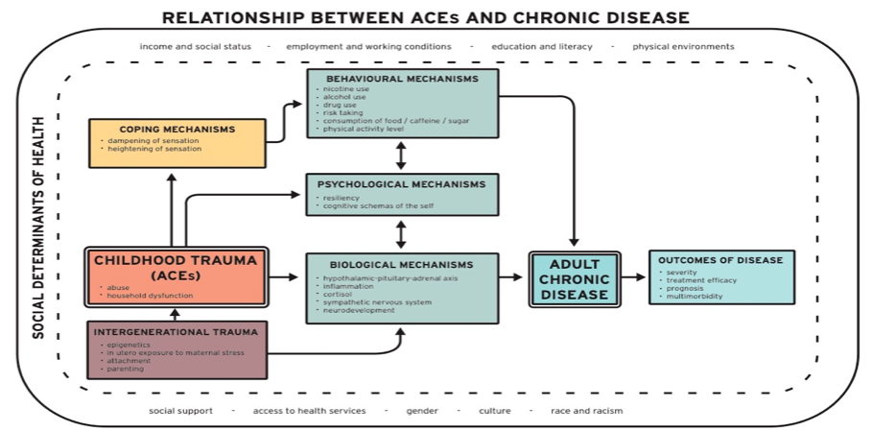
Notes:
Kara
-Provide a quick run down of the model
-Intro the next session where we will talk about this more in detail
-Coping is coping. If that’s what gets them through another day, then ok.

Slide 20
Kara – Spaces to Support
Mechanism | Approach
Intergenerational Trauma | -Connection to cultural or spiritual needs -Parenting supports
Personal Trauma | -Trauma therapy
Biological | -Medication, supplements, eating plans -Psychoactive assisted psychotherapy -Mindfulness, biofeedback, somatic therapies
Psychological | -Resilience training -Schema therapies
Behavioral | -Motivational interviewing -Increasing or decreasing behaviors -Harm reduction
Notes:
Kara
-Brief overview
-Connect back to the model

Slide 21
Kara – Spaces to Support
Motivational Interviewing
Behavior
Change
Harm
Reduction

Slide 22
When You Screw Up…
Notes:
Marie:
-Discuss that we make mistakes and are never going to offer perfect care.
-However, repair can be extremely powerful for both the provider and the patient
-Own our imperfections. Being vulnerable with our patients typically increases our patients trust in us, not decrease it.
-Notice that we make mistakes
-Really work to understand the perspective of your patient and what happened
-Sincerely apologize
-Reflect and take steps to prevent it from happening again

Slide 23
Authentic Apologies
Understand the other persons perspective
Own what’s yours
Label the problem and the impact
Actually say sorry
IF appropriate offer context – not an excuse
Ask what they need to move forward or to repair.
Notes:
Kara to discuss slide, Marie to add perspective.
-Marie to add perspective on what an authentic apology and repair attempt looks like
-Outcome over intent. Excuses don’t go well. I’m sorry you feel that way is MORE HARMFUL!
-Avoid things like “BUT”.
-Fact finding mission to determine the causes and conditions.
-We may do everything in our power and may have done “all the right things” and the response is still hurt.

Slide 24
Repair After the Apology
Do what you said you would do
Step into curiosity to understand what happened and what can be different.
Circle back to your patient if appropriate.
Notes:
Marie:
-Affirmation on the persons experience. Taking responsibility and engaging in empathy is acknowledging what happened and what can be done to be better.
-I did this thing, this is the impact, I’m going to do better, the ACTUALLY take the steps to do differently.
-Fact finding mission, remove shame. Curiosity.

Slide 25
Case Study - Revisited
26 yo male presents with shoulder pain after a weightlifting injury at the gym. He wants to get better quickly so he can get back to working out.
Had a rough childhood and used substances as a youth to cope. No substances since 20 yo.
Taking a pre-workout, BCAA’s, creatine, and OTC sleep.
Tried rest, ice, and OTC pain relief. Reported they didn’t help. Hesitant about physiotherapy.
Notes:
-Think – pair – share activity.
-1 min to think on own
-5 min to do small group work
Have them reflect again on the cases they thought about before:
Anything they would do differently now?
Where might bias come in?
In the original conceptualization, where might they have fractured the relationship?
How would they go about doing the repair?

Slide 26
Kara Irwin - Kara.Irwin@ucalgary.ca
Marie Ferraro – marie.ferraro@aawear.org

Slide 27
May Collab Forums
Thursday, May 12th 7:30-8:30 pm
Trauma Informed Treatment Planning: The Tools & How to Use Them with
Kara Irwin, M.Sc., R.Psych
Thursday, May 26th 7:30-8:30 pm
Gender & Chronic Pain – Women’s Experiences Through an Intersectional Lens with
Dr. Fiona Webster
This session is free and open to all interdisciplinary team members.

Slide 28
Not a member of the CMN?
Join today to get on the mailing list for upcoming events and resources!
Membership is always free
Participation is up to you – join as a general member, or participate in mentorship as a mentee, mentor, or both!
Check out the website for more info:
https://cmnalberta.com/

Slide 29
Chronic Pain Gains in Alberta: An ECHO Series
What is ECHO®?
Interactive online medical education program featuring real cases from YOU
“All teach, all learn” ideology
Active discussion around real cases to provide participants with feedback, guidance, and peer support
Additional benefits:
Flexible
Free
Accessible
Who can participate?
All Alberta-based primary care health care providers
Learn more at www.cmnalberta.com/ECHO

